Slide 1

UNIVERSITY COURSE MANAGEMENT SYSTEM
Student Name: Praise MUTIJIMA
Student ID: 25954
Course: Database Development with PL/SQL (INSY 8311)
Lecturer: Eric Maniraguha

Slide 2
❓ PROBLEM STATEMENT & GOALS
🔍 Problem:
🎯 Goals:
Manual course registration is error-prone.
Automate registration and grading.
Grading processes are inefficient.
Prevent scheduling conflicts.
Academic records have limited accessibility.
Ensure secure access to records.

Slide 3

🏗 System Architecture Overview
Core Technology
Managed Entities
Built entirely using Oracle PL/SQL for robust database operations.
Students and Professors
Courses and Enrollments
Schedules
User Roles
Students: register, view grades.
Professors: manage grading.
Admins: manage schedules, assignments.

Slide 4
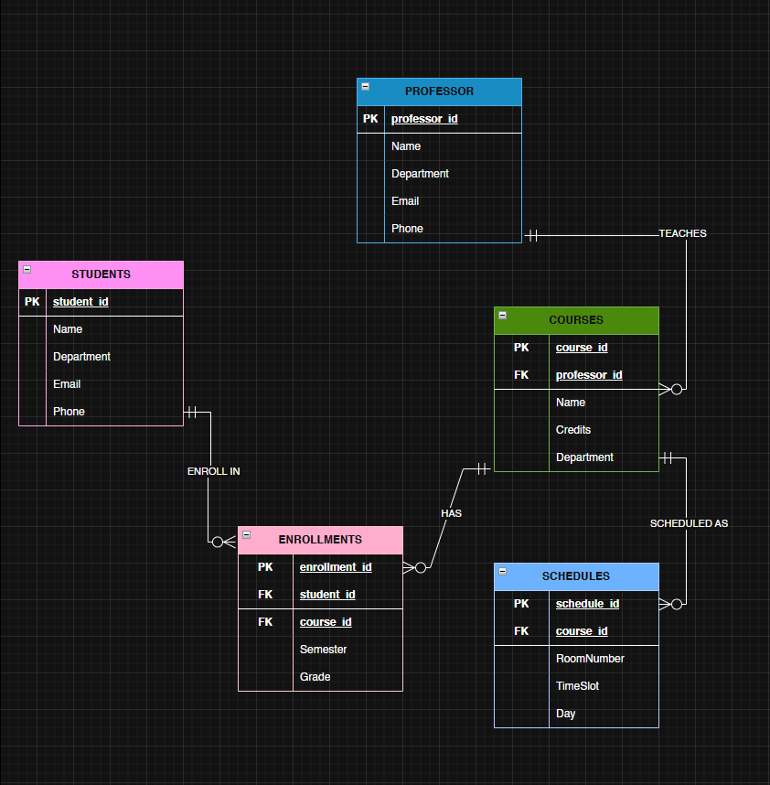





🧱 ER Diagram
The Entity-Relationship Diagram illustrates the core relationships.
Students
Professors
Register for courses.
Teach courses.
Schedules
Courses
Enrollments
Organize course times.
Offer academic content.
Link students to courses.

Slide 5
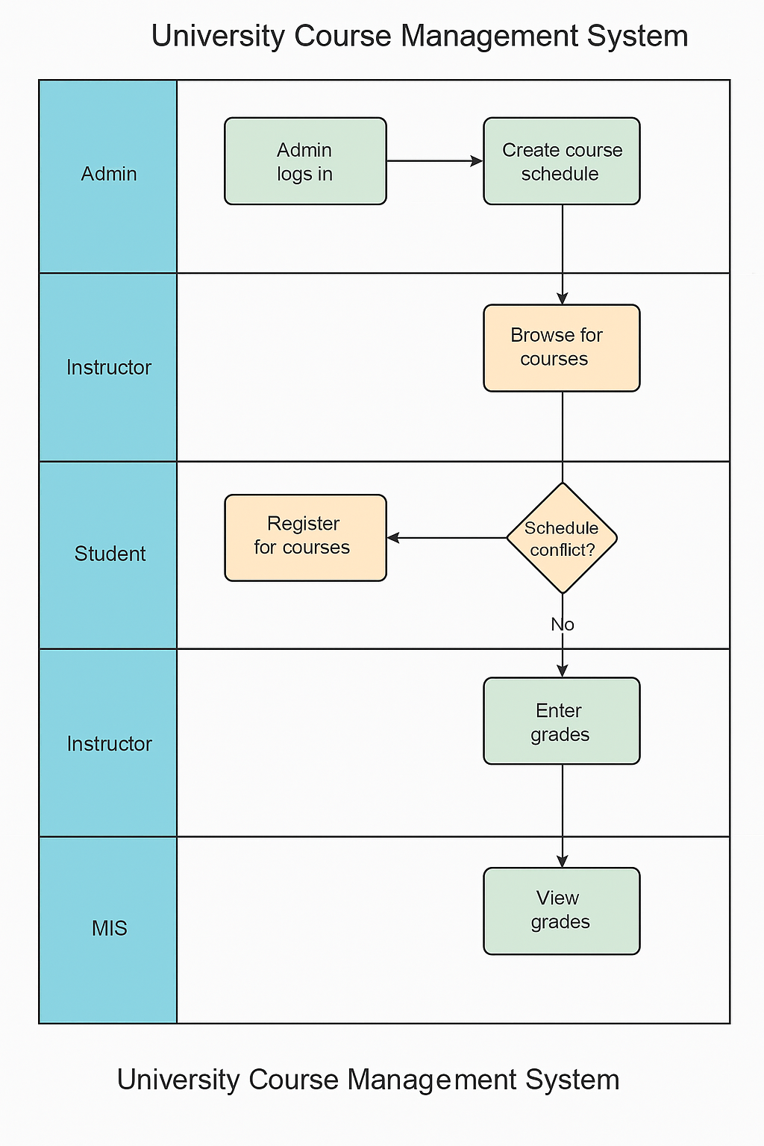




🧭 Business Process Model
This swimlane diagram outlines the key interactions within the system.
Admin
Creates and manages course schedules.
Professor
Assigns grades to enrolled students.
Student
Registers for courses and views grades.
MIS
Validates and stores all academic data.

Slide 6










🔁 Key PL/SQL Features
Function
Procedure
fn_get_student_gpa calculates GPA.
proc_register_student automates enrollment.
Cursor
Iterates through student enrollments.
Triggers
Prevent DML on weekends, audit all DML actions.
Package
Combines reusable database logic.

Slide 7
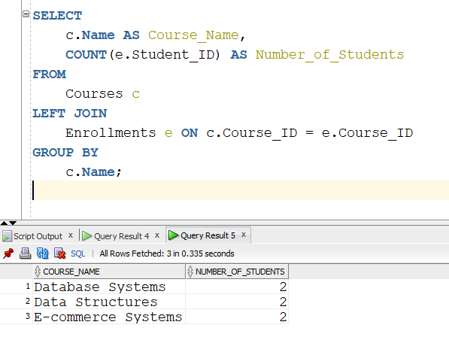
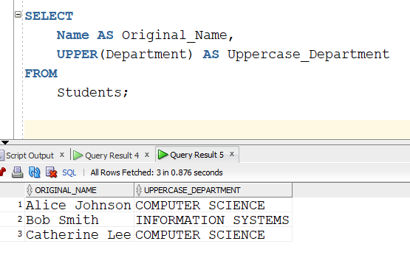
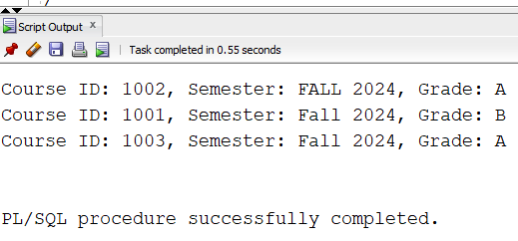
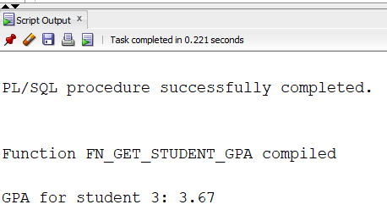
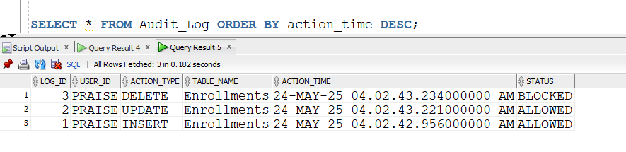
📸 Demonstration Screenshots
SQL*Plus/SQL Developer Output
Cursor and Function Output
Audit_Log Query Results

Slide 8
✅ Conclusion
Automated Workflows
1
Successfully streamlined university academic processes.
Enhanced Skills
2
Gained expertise in PL/SQL, data modeling, and BPM.
Reliable MIS
3
Built a secure, scalable, and reliable system.
Future Scope
4
Add login authentication and a web interface.

